Slide 1
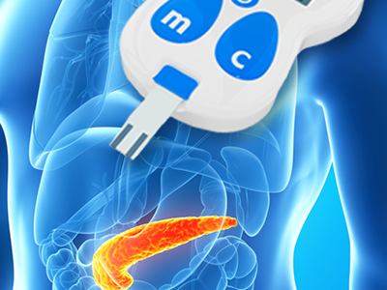
Diabetes Mellitus Disease Process

Slide 2

Diabetes Mellitus
The patient is a sixty one year old African American female living in Louisiana.
She is suffering from diabetes mellitus.
Had if from 2010, ten years now.

Slide 3
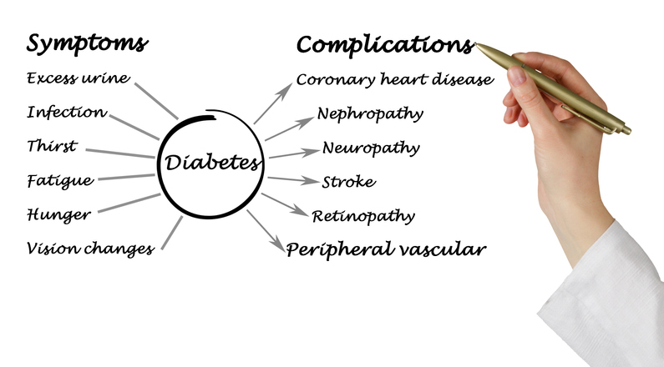
Complications
The complications she has had are neuropathy, eye damage and slow healing.
She had an amputation in 2010, shortly after diagnosis, to control infection.

Slide 4
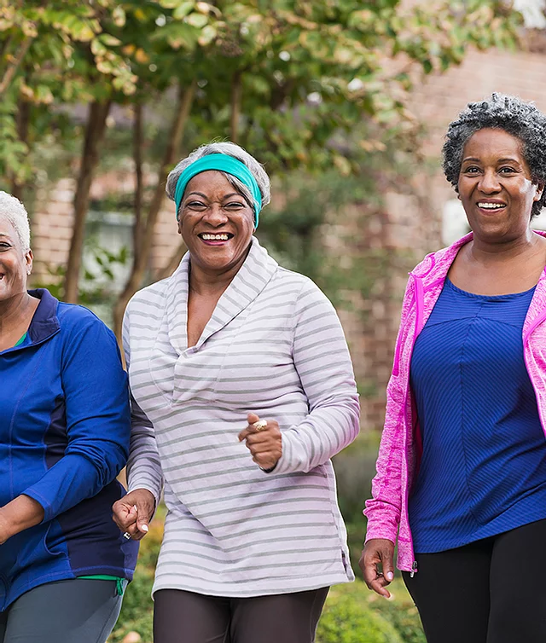
Community resources
Internal Medicine Clinic is a known community resource for diabetes patients.
They provide peer support for people living with diabetes.
An office is open every first Tuesday of the month.
The center offer comprehensive diabetes education, blood sugar screening, nutritional counseling and lifestyle management.

Slide 5
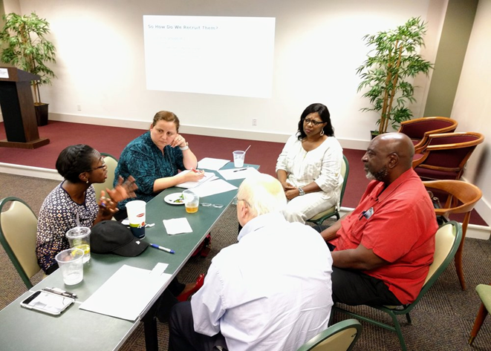
Community resources cont. …
Diabetes Education Center in Lake Charles empowers patients through self-management.
They can guide patients to adopt a meal plan that avoids raising sugar levels.
They have a certified diabetes educator, nurse educator and registered dietician.
The services are accessible, but the patient will travel for 30 minutes to get to Lake Charles.

Slide 6
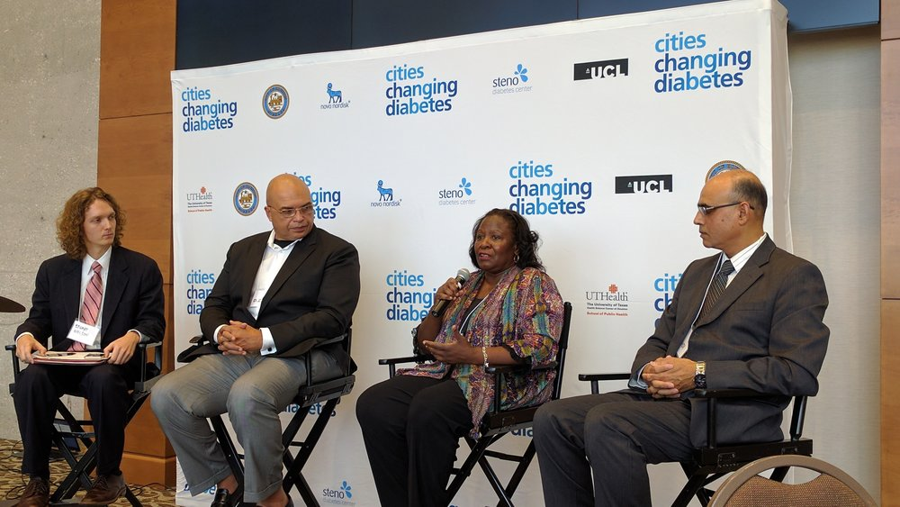
Community resources cont.
The third community resource center is Lake Charles Memorial Health System.
The center offers comprehensive diabetes education, blood sugar screening and lifestyle management.
The services are available on inpatient and outpatient basis.
The patient would need a mandatory mask because of covid 19.
The centers are open from 8:00 am to 5:00 pm.

Slide 7
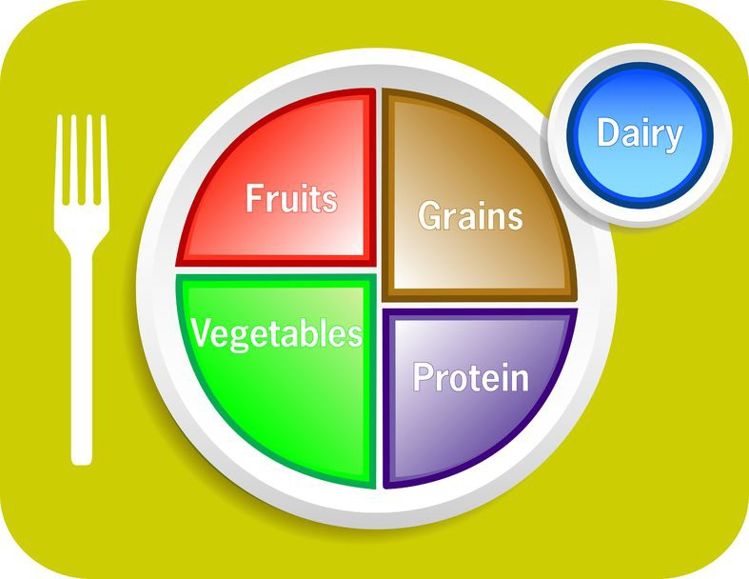
Importance of diabetes education centers to the patient
The patient would learn new ways of monitoring her sugar level.
The centers emphasize on exercise and proper diet, which would help monitor sugar levels (Saulsberry & Peek, 2019).
Peer support groups can keep the patient motivated when she feels depressed.
The centers can draft exercise schedules for patients depending on their weight (Hill-Briggs et al., 2021).
Centers help patients to adjust their treatment plans as needed.

Slide 8
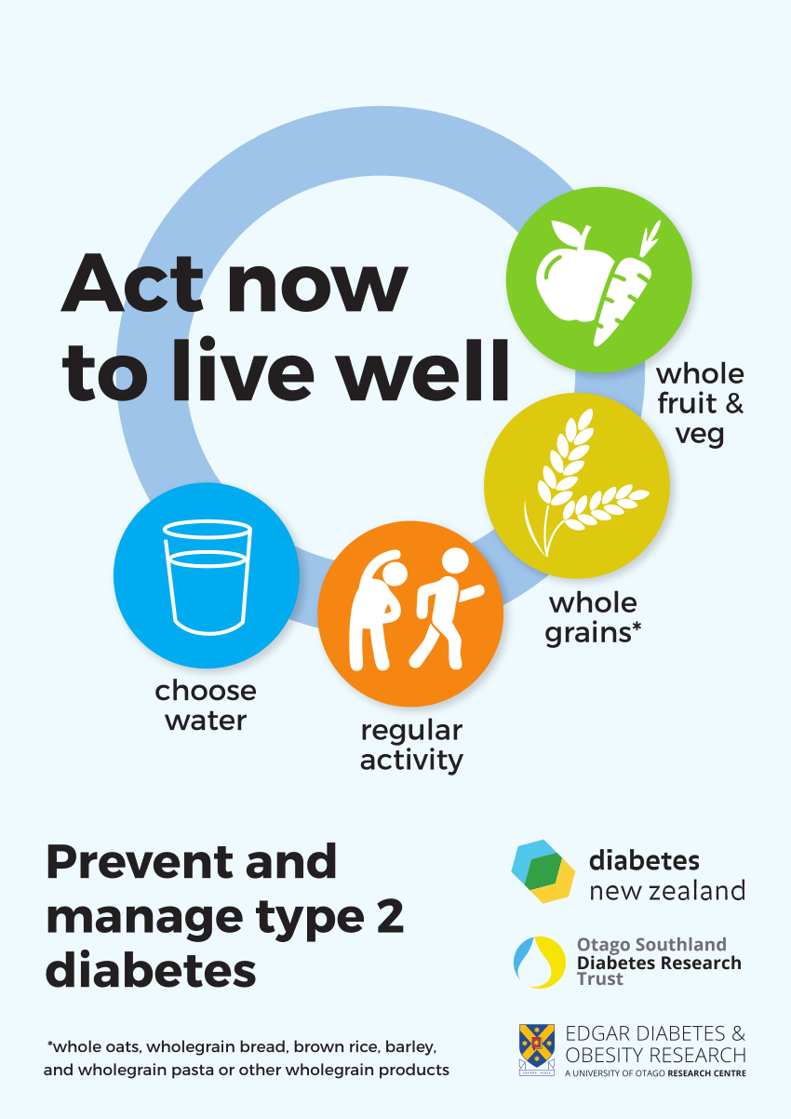
How the patient was helped
She learned how to take smaller potions at regular intervals.
She started exercising more.
She met local peers suffering from diabetes.
She got a new diet plan that incorporates all she needs to manage the disease.

Slide 9
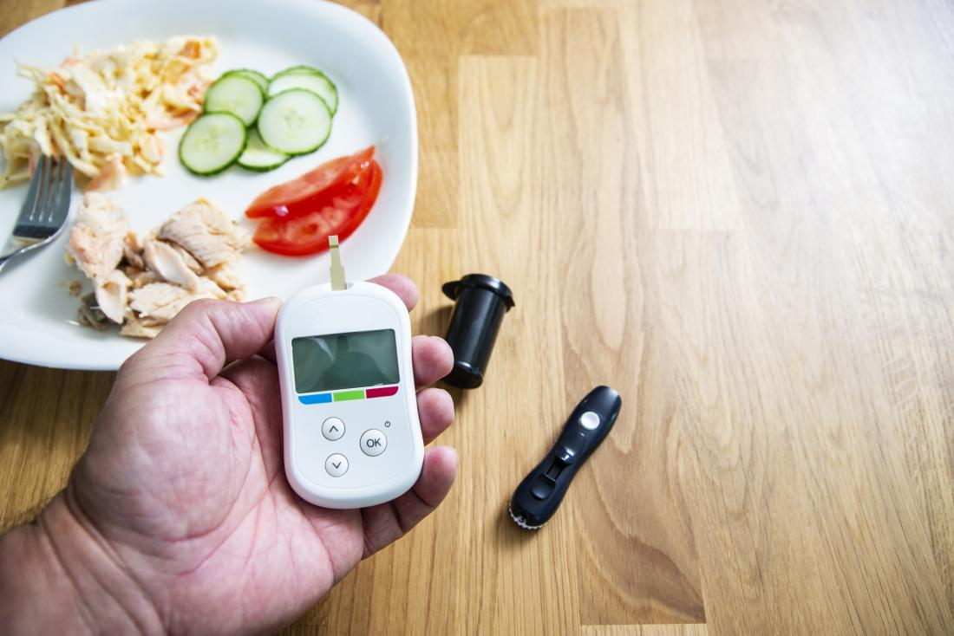
The interview
The patient talked about her history with diabetes and how treatment options have changed over the years.
Initially, she could not take some foods.
Over time, she got a new diet plan that helps her control her sugar levels.
Although she takes insulin medication, she also takes every food but in controlled amounts.

Slide 10
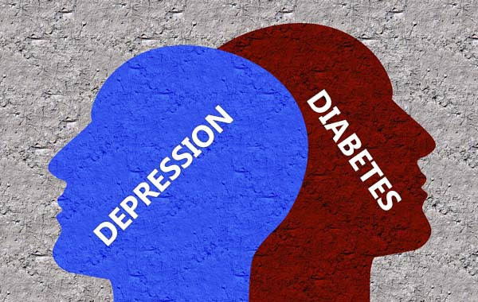
The interview
The patient mentioned being depressed a few years back.
She had a poor metabolic and glycemic control.
She learned new ways of managing stress, and stopped pitying herself.
Peer groups have helped her adapt to her new lifestyle.
She has also joined exercise groups and walks every day to stay fit.
Although the resource centers are far, she has a son who takes her for peer meetings over the weekend.

Slide 11
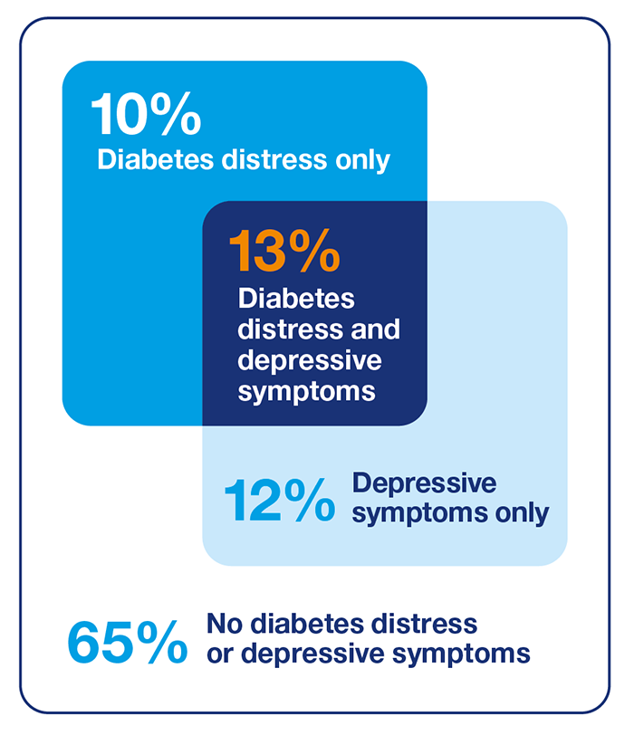
Conclusion
Although the patient has been living with Diabetes mellitus for a while now, changes in treatment keep on happening.
She had kept in tough with resource centers and she is maintaining a healthy lifestyle.
Peer groups have helped her keep a positive mindset.

Slide 12
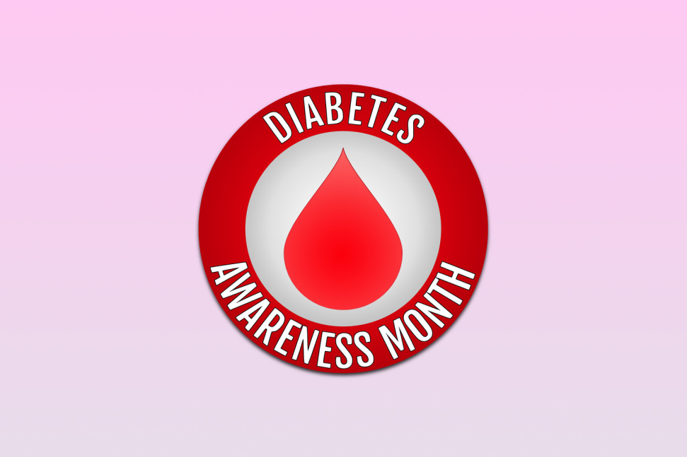
Reference
Hill-Briggs, F., Adler, N. E., Berkowitz, S. A., Chin, M. H., Gary-Webb, T. L., Navas-Acien, A., ... & Haire-Joshu, D. (2021). Social determinants of health and diabetes: a scientific review. Diabetes Care, 44(1), 258-279.
Saulsberry, L., & Peek, M. (2019). Financing diabetes care in the US health system: payment innovations for addressing the medical and social determinants of health. Current diabetes reports, 19(11), 1-8.

